Slide 1
The Berkeley Initiative for Transparency in the Social Sciences Onboarding for Undergraduate Research Apprentice Program
Fernando Hoces de la Guardia
February 7th, 2020
Notes:
Total time: 10mins

Slide 2
Our Mission
Generate evidence | on problems and solutions through meta-research led by BITSS investigators and our broader community.
Increase access to open science education | building capacity to recognize and conduct transparent and reproducible science through training, access to curricula, financial support, and a growing network of advocates and allies.
Strengthen the scientific ecosystem | enabling researchers and institutions to effectively and equitably change norms at scale through open science policy and protocol development.
Notes:
TED
Highlight new 3 E’s framing

Slide 3
Team Structure
Ted Miguel – Faculty Director
Carson Christiano – CEGA Executive Director
Program Staff:
Katie Hoeberling (Manager
Aleks Bogdanoski (Associate)
Zach Wilder (Intern, 25%)
Research Staff:
Fernando Hoces de la Guardia (Project Scientist)
Joel Ferguson and Nick Otis (Graduate Student Researchers, 25 – 50%)
Jiahui (Sophia) Bai, Orianna Jia, Emma Ng, Ryan Scholes (URAPs, 25%)
Notes:
TED
Not much has changed since last year.

Slide 4
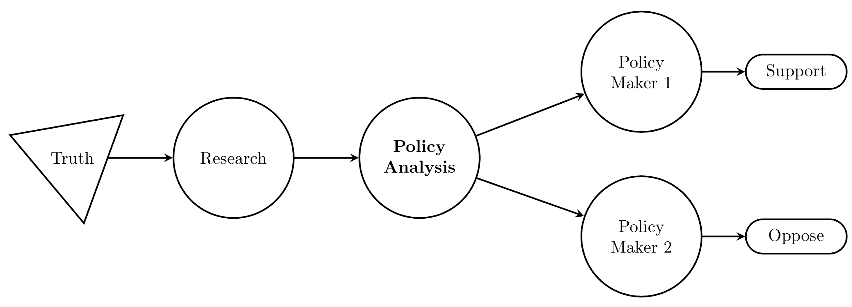
What is the focus of Open Science?

Slide 5
Open Science
Issues:
Scientific misconduct
Publication Bias
P-Hacking
Replications problems
Solutions:
Ethical research
Registrations & PAPs
Guidelines and Protocols
Reproducible workflow

Slide 6
What has BITSS done to address this issues?
Awareness on the problems and solutions: papers, manuals and convenings (RT2)
Learning: funded and conducted research on research; hosted pre-prints
Community building: Annual Meeting, Catalysts, blog

Slide 7
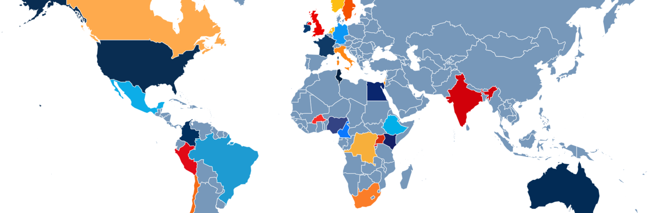
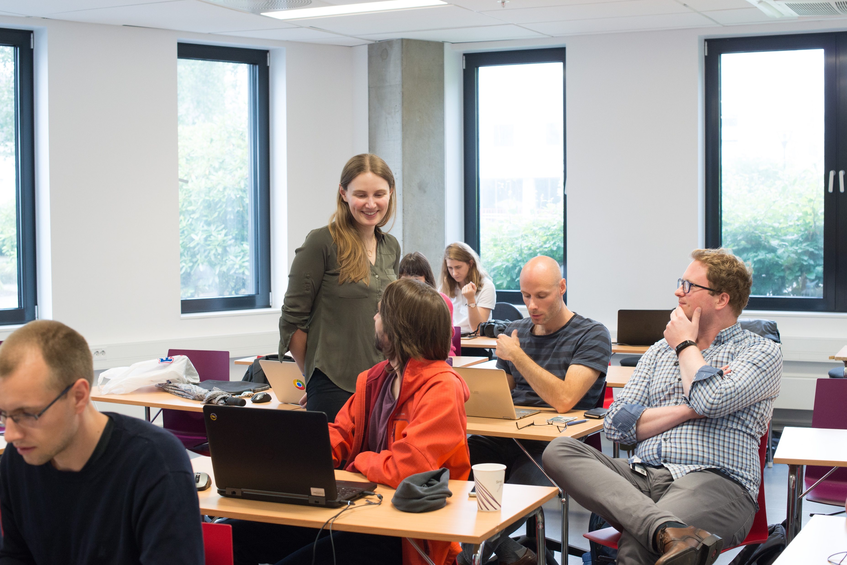
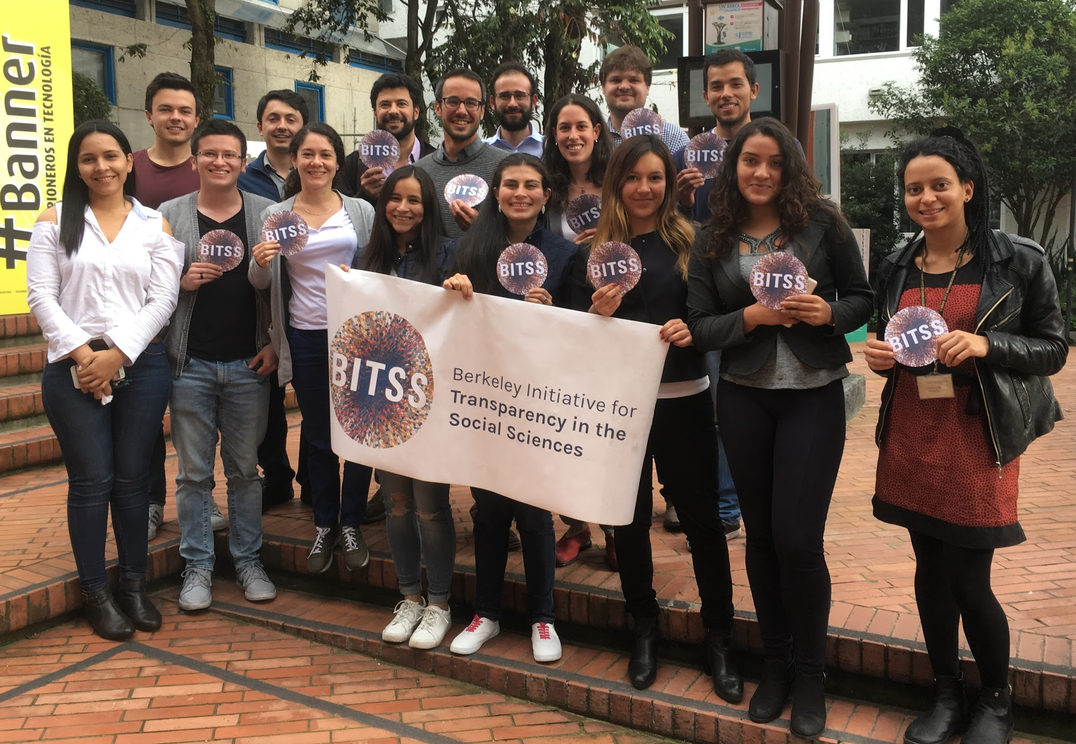
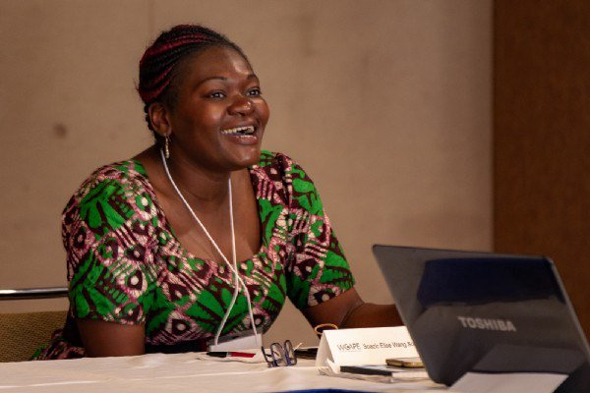
Our Network
BITSS Catalysts are PhD students, faculty, and researchers committed to advancing the teaching, practice, funding, and publishing of transparent and reproducible research.
120+ academics and practitioners;
90 institutions; 30 countries

Slide 8
What is BITSS doing today?
Changing norms: RR at the JDE, best practices at the IDB and INSP
Learning: More meta-research: 3S, Citations study
Community building: AM, Catalysts, RT2

Slide 9



Slide 10
Registered Reports
Registered Reports are empirical research articles that are peer-reviewed and accepted for publication before the results are known.
Confirmation of decision to publish
Peer review & decision to publish
Develop research design & analysis plan
Collect & analyze data
Write up paper
Publish paper

Slide 11

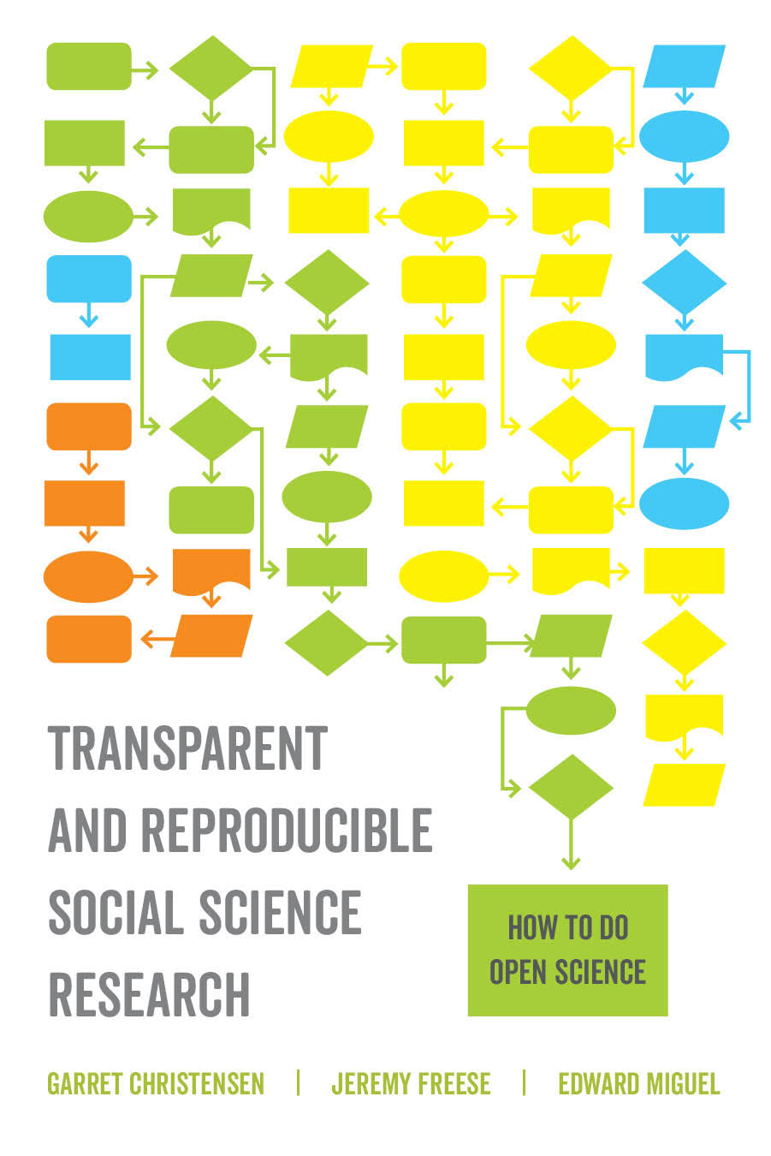
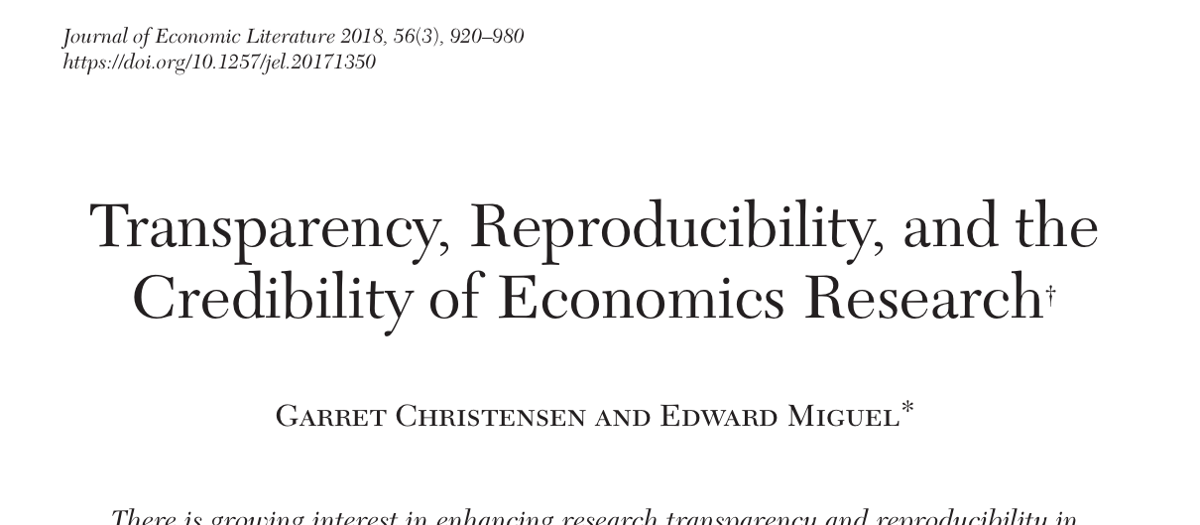
Recent Publications

Slide 12
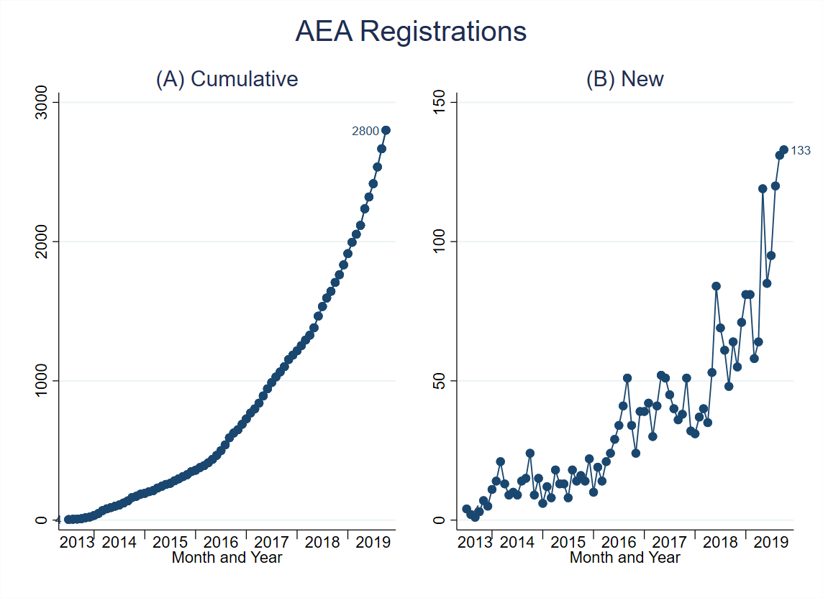
Change is happening
Record number of registrations on the AEA RCT Registry in 2018!

Slide 13
What is in the horizon for BITSS?
Community building: AM, Catalysts, RT2
Computational reproducibility: in the classroom and in papers
Super Forecasters in Social Sciences
Open Policy Analysis

Slide 14
Why Bring Open Science into Policy Analysis?

Slide 15
Relevance
Main consequences of policy analysis that lacks openness:
Policy makers can cherry-pick facts
Hinders automation and/or systematic improvements of reports
Unclear how research affects policy estimates

Slide 16
Our Framework for Open Policy Analysis
- Unified output
- Clear output-input link
Open Output
Open Analysis
Open Materials
Policy Makers
Output
Staffers/Advisors
Assumptions
- Open Code
- Open Data (raw & final)
- Open Report
Policy Analysts & Researchers
All details
Policy Analysts & Researchers
All materials
- Common file structure
- Label data, research, guesswork
- Make code/spreadsheets reproducible
- Use a version control

Slide 17
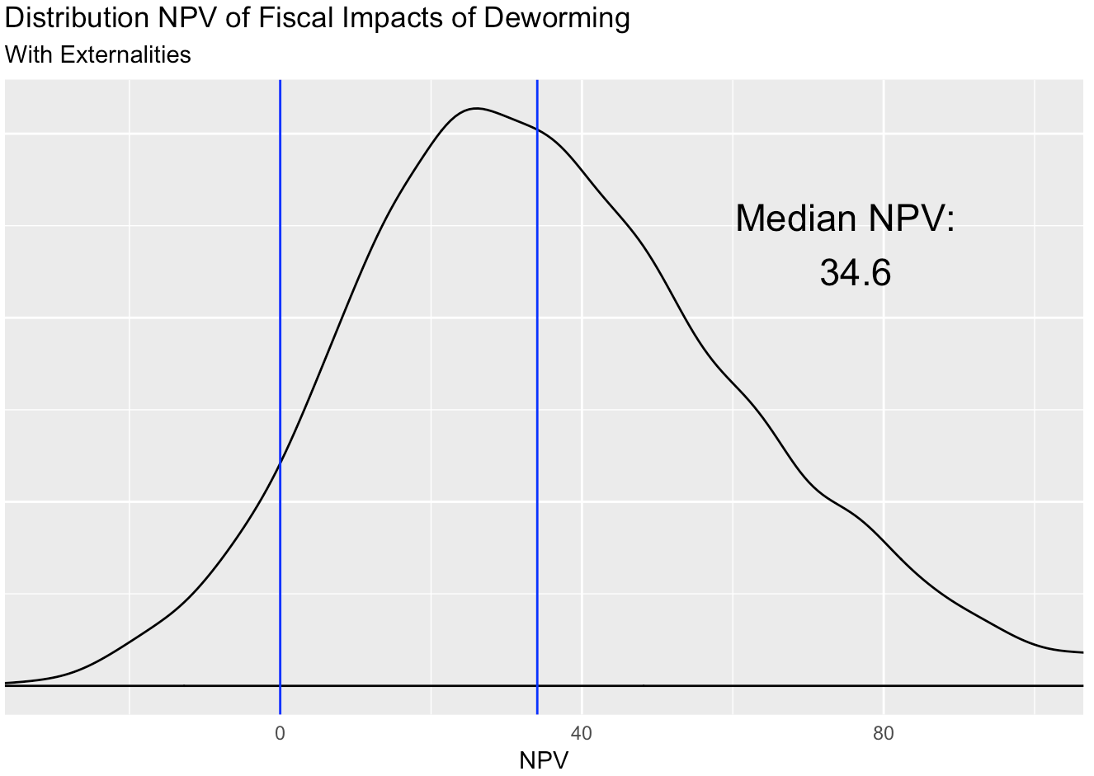
One clear output for policy makers

Slide 18
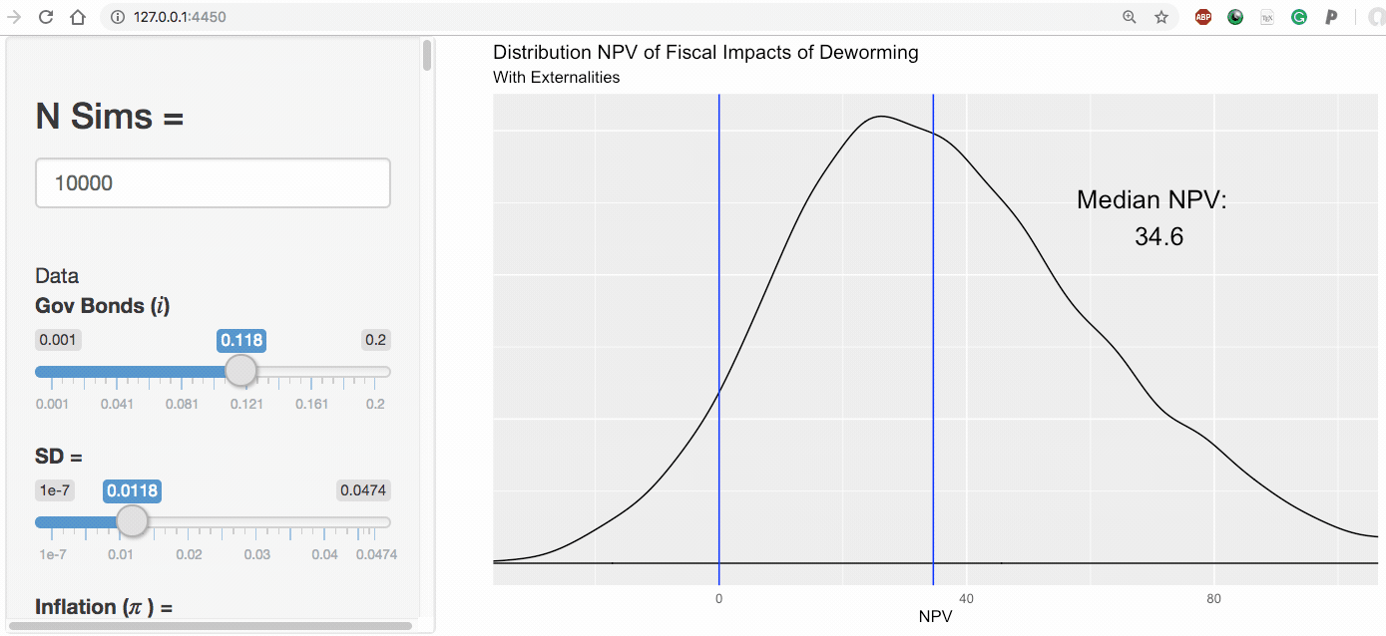
Clear input-output
link

Slide 19
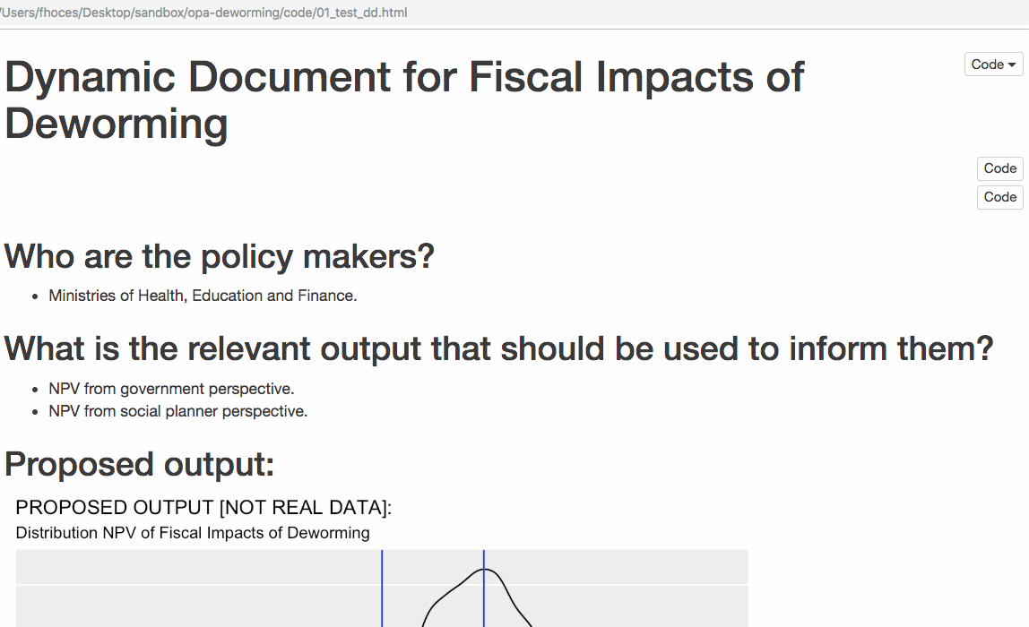
Complete dynamic documentation

Slide 20
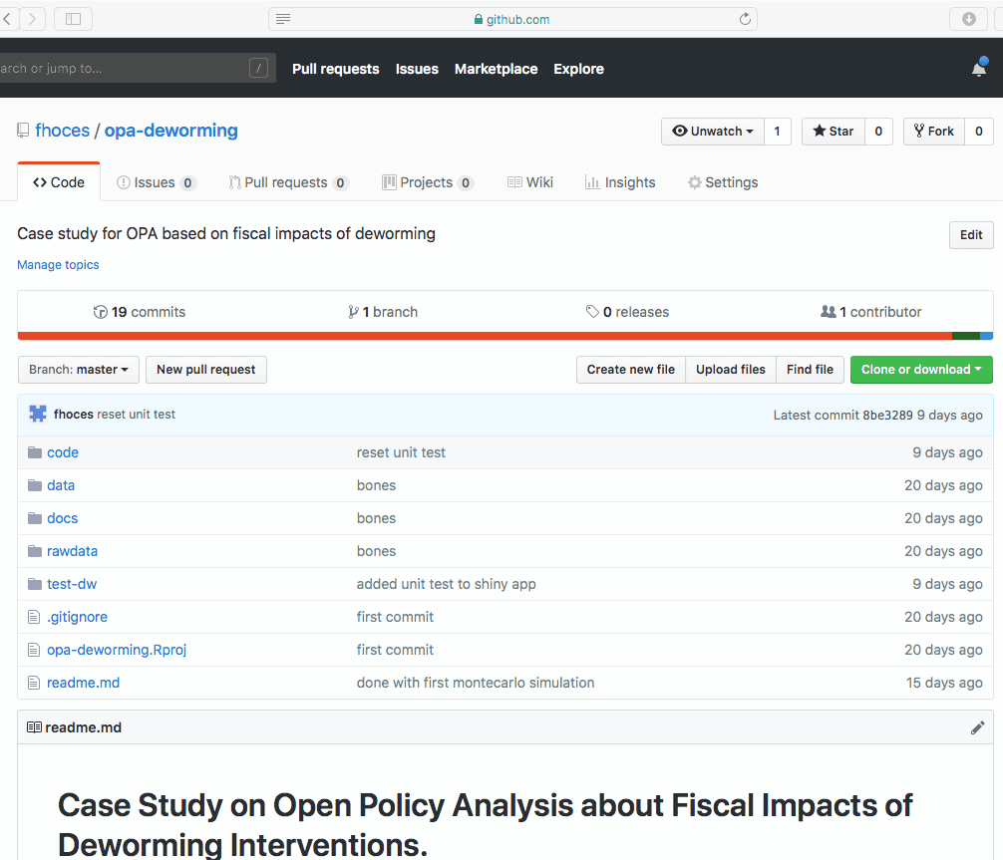
Complete reproducible repository

Slide 21
Demo of a completed OPA

Slide 22
Our Plan for OPA
Develop framework to support OPA. Paper here
Support transition/adoption of OPA, and develop case studies
Train students and analysts
Raise awareness
Notes:
Develop framework to support OPA
Principles
Guidelines
Support transition/adoption to OPA, and develop case studies
Minimum wage in the US
Deworming in Kenya
Train students and analysts
RT2-type of curriculum (policy/economics)
Raise awareness
This panel
Future convenings
Ongoing presentations (so far APPAM, Evidence Action, GSPP, EDI, GiveWell, AIR, CBO, IDB, AM1)

Slide 23
URAPs for OPA
We are looking to scale-up the footprint of OPA across policy domains.
The goal is to have an ongoing pipeline of case studies supporting as many analysts and researchers as possible in the creation of OPAs.
This means increasing capacity in
Strengthening the connection to current policy analyses
Systematizing some of the tasks to “open” a policy analysis
Systematizing some of the visualization efforts
Long term objective: 10+ URAPs per semester.
Your initial experience and output will directly inform the larger initiative.

Slide 24
URAP Timeline
Start: today (2/7). Ends: last day of class (5/1). Email me week of midterms.
Week. 9-11 or 12-14 hours.
Ideal time split: 30% learning a new skill, 40% applying that skill, 30% doing something repetitive and no-so stimulating.
Semester: 11 weeks.
1 – 3: mainly training. 4 – 9: mainly adding content (ends 4/17!). 10 & 11: Summarizing, developing guidelines for future URAPs.

Slide 25
URAP Standard Operating Procedures (SOPs)
End of the week send me an email with ([URAP] in the subj):
Activities performed. Examples: learned git, learned R, learned about PA, summarized # reports, pushed # commits, clean shiny app code, etc.
The number of hours worked.
Deliverables for next week.
Individual/small team meetings each Monday.
Once a month: present to the whole team.
Set up the PA/D+ group in the morning and the D+/PA team in the afternoon.

Slide 26
URAP tasks
Three tracks: Data Science (DS), Data Visualization (DV), Policy Analysis outreach (PA).
Sophia (DV,DS), Ryan (DS), Emma (PA,DS), Orianna (PA)
All tracks must learn how to use Git/Github.
DS: spend first week(s) learning R (screencasts) and reviewing this file.
DV: spend first week(s) learning Shiny (book) and reviewing these files.
PA: spend first week(s) learning about the wealth tax, deworming (section 5 of this paper), and the OPA framework.

Slide 27
What to do when you have questions
Administrative questions: email Aleks.
Programing questions: (1) stackoverflow/web (2) your teammates (3) me.
Policy analysis/Methods questions: me/web.
Questions to me: email/weekly meeting.

